Slide 1


Crafting Innovation
www.nordencommunication.com

Slide 2
Crafting Innovation
About
Norden Communication​
Headquarters
Comprehensive Portfolio
Global Presence
Commitment to Quality
Located in London, UK, Norden Communication has over two decades of history, initially focusing on delivering reliable and effective ELV and security solutions.​
Norden offers a diverse product range across six product verticals, including Surveillance, Cabling Systems, Public Address, Access Control, Fire Alarm Systems, and UPS Systems, with continuous expansion into new areas. Our commitment to quality, reliability, and innovation ensures safety, connectivity, and efficiency for businesses worldwide.
Over the years, Norden has expanded its reach, servicing markets across Europe, the Middle East, Africa, and Asia, meeting the demands of diverse industries worldwide. With operations in 50+ countries, Norden continues to deliver innovative solutions tailored to evolving security and infrastructure needs.
Norden operates with a dedicated quality assurance team and adheres to an ISO-certified quality management system, ensuring all products meet the highest standards. ​ Our products and solutions adhere to industry standards and regulatory compliance requirements.
2

Slide 3
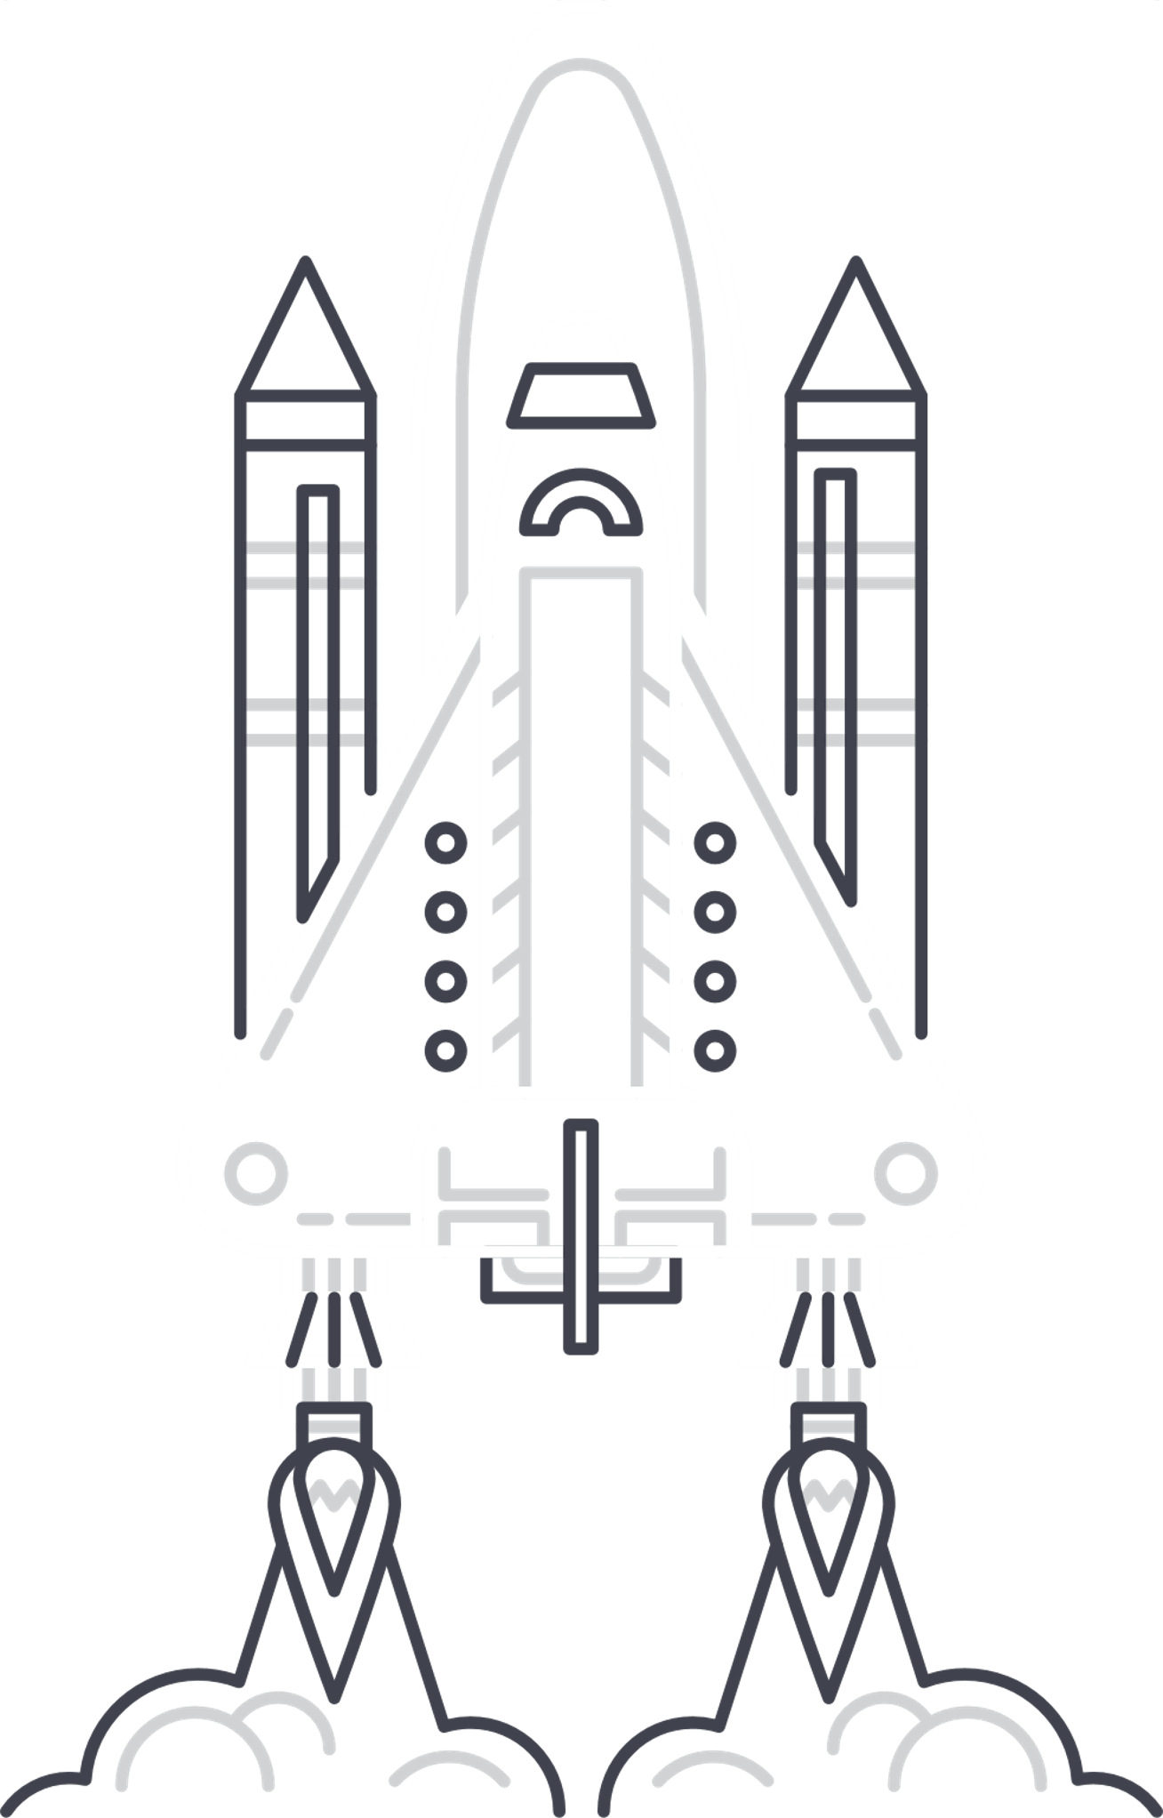
Crafting Innovation
Mission
At Norden Communication, we are dedicated to crafting innovative technology that enhances global safety, security, and communication. Our mission is to protect lives, secure assets, and facilitate seamless connectivity by delivering cutting-edge, reliable solutions.​
As an ethical, green, and environmentally conscious company, we are committed to sustainability in every aspect of our operations. We pride ourselves on being a culturally diverse and inclusive employer, fostering a collaborative environment that values and respects differences.​
Our aim is to become a trusted, mono-brand, single-source provider for safety, security, and communications solutions globally, driving progress and excellence for a safer, more connected, and inclusive future.​
3

Slide 4







Crafting Innovation
Our Product
Portfolio
Norden Surveillance System
Norden
Cabling System
Norden Public
Address System
Norden Access Control
System
Norden
Power System
Norden Fire Alarm System
4

Slide 5

NORDEN INTELLIGENT SOLUTION

Slide 6


NORDEN INTELLIGENT SOLUTION
Norden Intelligent Solution is an Automated Infrastructure Management (AIM) system powered by CPID Technology (Connection Point Identification).
This innovative solution simplifies and optimizes IT infrastructure management by providing real-time monitoring of point-to-point connectivity at the physical layer.
Utilizes advanced technologies to automate and optimize the efficient, secure management of physical and virtual network assets, enabling businesses to remain competitive in the fast-changing IT landscape.

Slide 7
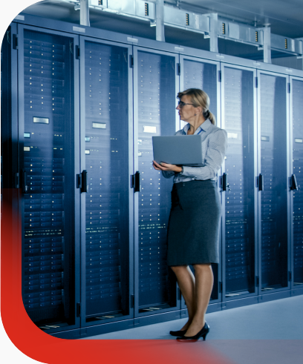
NORDEN INTELLIGENT SOLUTION
Key Features :
  Real-time visibility into network connectivity
  Support for interconnect and cross-connect topologies
  Comprehensive monitoring and control of all physical-layer network components
  Minimized network downtime with enhanced performance
  Automation to eliminate manual errors in workflows
  Management of all IT assets down to the final port
  Reduced power consumption for increased efficiency

Slide 8
BENEFITS OF NORDEN INTELLIGENT SOLUTION
Reduces downtime by proactively identifying and resolving issues for seamless network performance.
Automates processes to eliminate manual errors, streamline workflows, and enhance productivity.
Supports diverse network topologies for flexible and efficient integration.
Lowers management and maintenance costs by minimizing reliance on manual interventions.
Optimizes resource utilization to maximize the value of IT assets.
Reduces power consumption through intelligent resource allocation, lowering operational expenses.
Contributes to sustainability by minimizing environmental impact.

Slide 9
INTELLIGENT HARDWARE FEATURES
Designed to support both cross-connect and interconnect network topologies, accommodating copper, fiber, and hybrid solutions with data rates of 10 Gbps, 40 Gbps, and 100 Gbps.
It features a space-efficient 0U rack design, enabling unlimited port scalability.
Key Features :
  Supports interconnect and combined cross-connect configurations.
  Smart ID Key technology stores link data (switches, racks, cables, revisions).
  Rack lights and LED indicators guide technicians and signal make/break status.
  Advanced management frames and Zero-U collector installation for efficient handling.
  Integration with environmental controllers and sensors.
  High security with auto-detection of new or moved components and audible alerts for unauthorized operations.

Slide 10
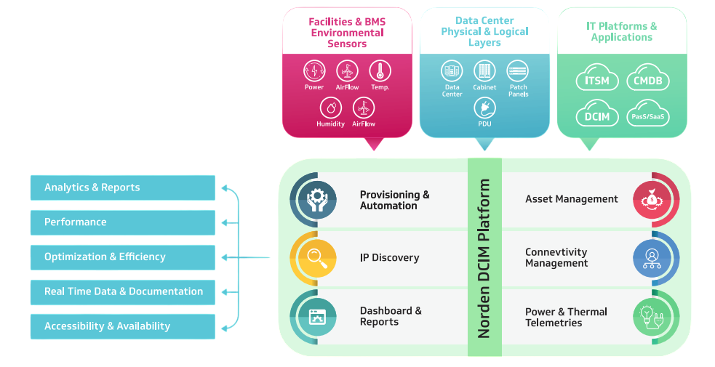
NORDEN DCIM SOFTWARE

Slide 11
Norden Intelligent Solution – Revolutionizing Data Management
Norden Intelligent Solution offers :
  End-to-end visibility for seamless asset management and security with real-time tracking of devices and network connections
  Simplifies operations and reduces downtime through instant access to critical data for faster troubleshooting.
  Strengthens network security with immediate detection and precise location identification of unauthorized devices.
  Optimizes infrastructure with automated reports on switch port utilization, reducing waste and improving resource efficiency.
  Simplifies capacity management and device provisioning with intuitive drag-and-drop functionality.
  Ensures continuous data center health with integration of environmental sensors for real-time monitoring of power, humidity, and temperature.

Slide 12
THANK YOU
www.nordencommunication.com

